Slide 1
Importance of Shipping to the Global Society and Green Shipping
Yudhishthir Khatau
President, BIMCO
Seoul, Republic of Korea
The 8th September 2011

Slide 2
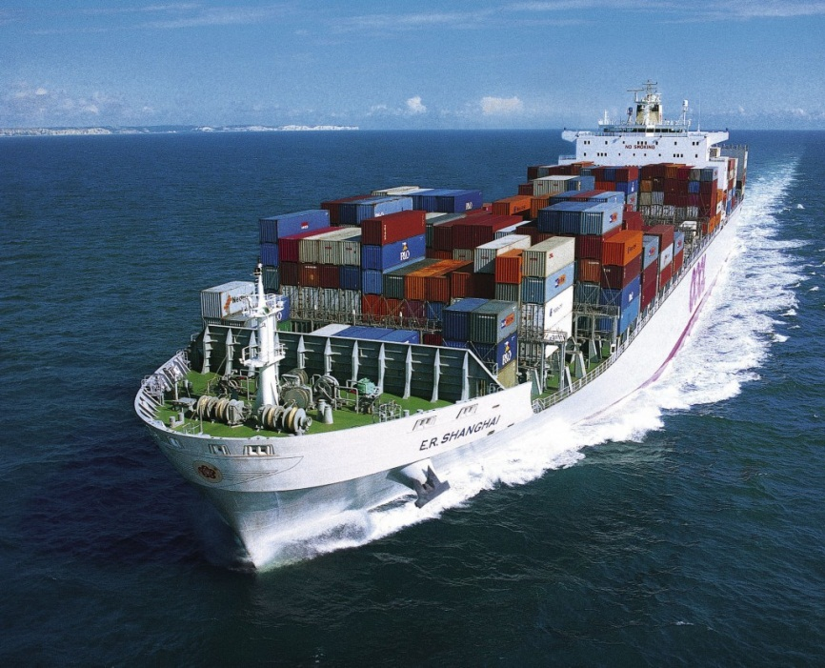
Umbilical Cord to World Trade
90 per cent of world trade.
Prerequisite for globalisation.

Slide 3
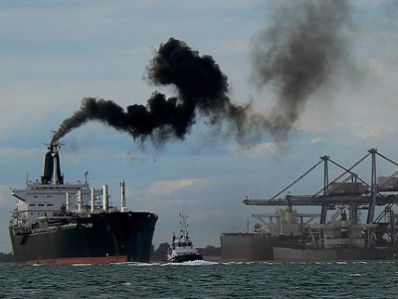
Globalisation
Key role accepted but!
Global rules needed – not regionalism.
Symbol of globalism.
Environmental impact.

Slide 4

Sustainable Green Shipping
Demand for greener shipping.
ECA’s.
Ballast water.
GHG.

Slide 5
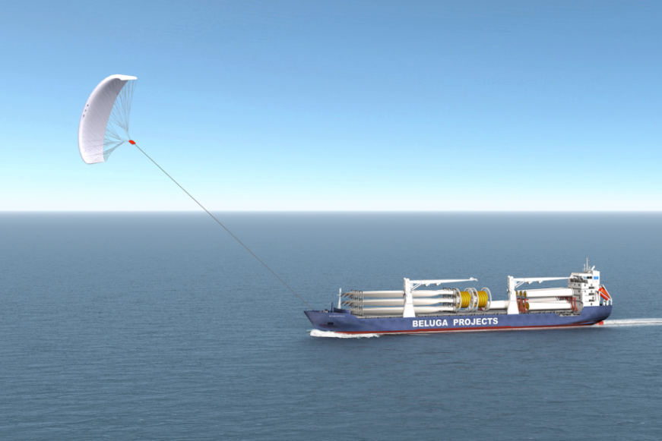
GHGs and Shipping
Responsibility.
Energy efficiency.
IMO in a key role.
Shipping is not a ”cash cow”.

Slide 6
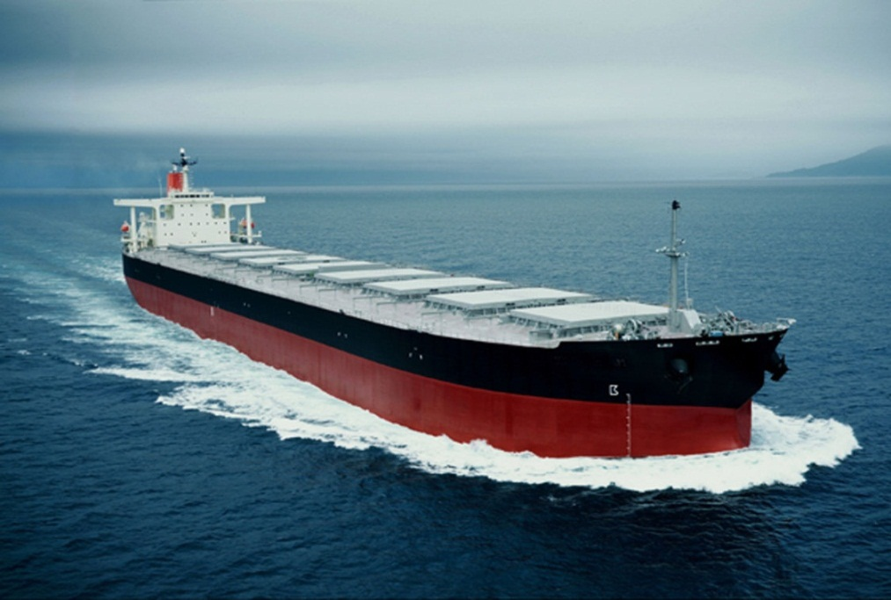
The Driver – Energy Efficiency!
Pure economics.
Cost driven – cost of fuel, cost of transportation.
Compliant fuels and Oil Companies.

Slide 7

Thinking Out of the Box!
Proactive innovations should steer shipping forward.
Higher cost of transportation – a threat to globalisation? Emerging economies?

Slide 8
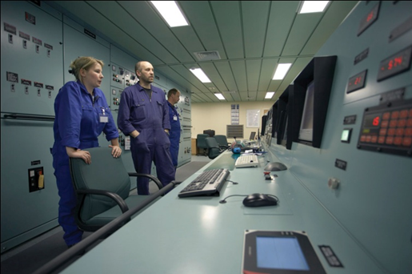
Employees’ Role
All must involve – from top to bottom.
Knowledge sharing, transparancy, internationally accepted rules - supports better compliance.

Slide 9
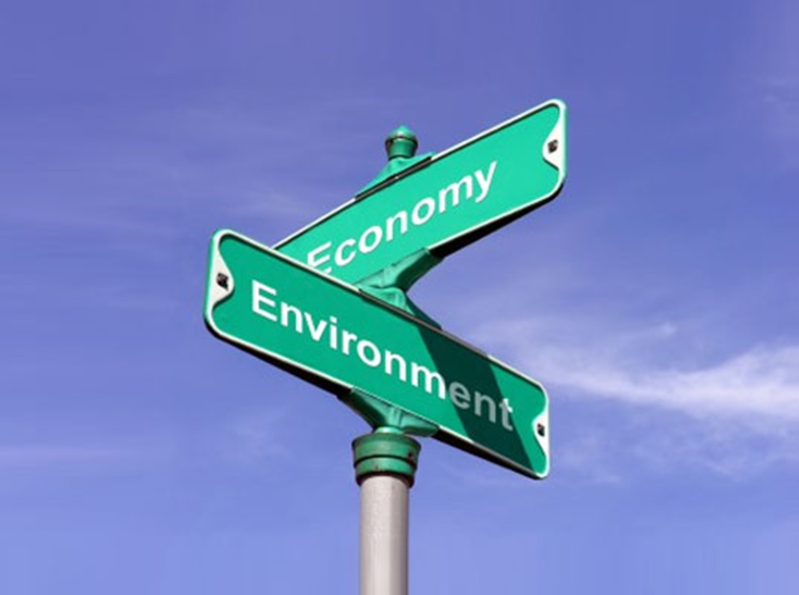
Green Shipping – Way Ahead
Is there a business case? Opportunities?
Feasibility.
Open mind on new practices and technologies.
Support development from the top.
Economically sustainable.

Slide 10
Thank you for
your attention.

